Slide 1
PHIL 201
Chapter 5
Categorical Propositions

Slide 2
Categorical Logic
Up to this point we have been relying on a seat of our pants analysis of arguments. This sort of thing is often very useful, but it fails in tough cases (like when people disagree about the validity of an argument).
What we need is a certain and objective method of evaluation.
Any such system should be able to: 1)clarify our language; 2)reveal its logical structure; 3)define the concepts of logic; 4)evaluate arguments.
Categorical logic is one such system. It originated over 2000 years ago in the work of a Greek philosopher named Aristotle.
Categorical logic focuses on one particular form of deductive argument—categorical syllogisms. CSs are arguments whose constituent elements are categorical propositions.

Slide 3
The Components of Categorical Propositions
A categorical proposition is a proposition (statement) that relates two categories.
A category is a class or group of things.
It is important to recognize that categories aren’t necessarily objective features of our experience, but just ways of carving up the world. When our goals change, our categories often change with them.
All CPs have a subject class/term (what you are relating) and a predicate class/term (what you are relating the subject class to).
The proposition asserts that all or some of the subject class are included in or excluded from the predicate class.

Slide 4
Standard Form CPs
Given that we can say something about all or some of the subject class, and that it can be included or excluded in the predicate class, we have 4 different ways in which categories can be related in CPs.
These 4 ways are called the Standard Form categorical propositions. To create them we need four elements:
Quantifiers: “All,” “No,” or “Some”
Subject Term: Noun or Noun Phrase
Copula: “are” or “are not”
Predicate Term: Noun or Noun Phrase

Slide 5
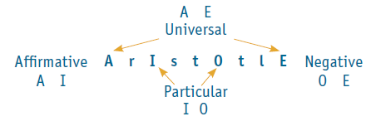
The Four Categorical Forms
All CPs are resolvable into one of four forms, symbolized by the corresponding capital letter:
CP Symbol Quantity Quality
All S are P. (A) Universal Affirmative
No S are P (E) Universal Negative
Some S are P. (I) Particular Affirmative
Some S are not P. (O) Particular Negative

Slide 6
Exercise 5A
Example
Some political documentaries are shows deserving of acclaim.
Answer
Subject: political documentaries
Predicate: shows deserving of acclaim
This is an example of an I-proposition.

Slide 7
Quality, Quantity and Distribution
As the table on the last slide reveals, all categorical propositions can be characterized by both their Quality and their Quantity.
Quality characterizes whether the categorical form of the proposition is inclusive (Affirmative) or exclusive (Negative).
A and I form propositions are affirmative, E and O form propositions are negative.
Quantity characterizes whether it is all (Universal) or part (Particular) of the subject class that is affirmatively or negatively related to the predicate class.
A and E form statements are universal, I and O form propositions are particular.

Slide 8
Distribution
Our analysis of the standard form CPs reveals more than just the quantity and quality of the propositions, it also reveals something about the categories related in the propositions.
Distribution refers to whether a proposition says something about the whole class or category or not.
A term is said to be distributed if the proposition makes an assertion about every member of the category named by the term; otherwise, it is undistributed.

Slide 9
Review of Distribution
A-propositions: All cats are mammals.
Subject “cats” is distributed; the proposition asserts that every cat is a mammal.
Predicate “mammals” is undistributed; the proposition does not make an assertion about every mammal.
E-propositions: No turtles are mammals.
Both subject and predicate are distributed; the proposition asserts that not even one turtle is a mammal and not even one mammal is a turtle.
I-propositions: Some students are sophomores.
Both subject and predicate are undistributed; the proposition does not make an assertion about every student or every sophomore.
O-propositions: Some cars are not fuel-efficient vehicles.
Subject “cars” is undistributed; the proposition does not make an assertion about every car.
Predicate is distributed, since at least one member of “cars” is excluded from every member of “fuel-efficient vehicles.”

Slide 10
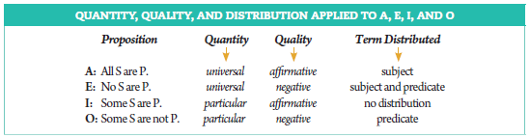
Quantity, Quality, and Distribution

Slide 11
Exercise 5B
Example I:
State quality, quantity, and distribution:
Some protein supplements are not healthy diet aids.
Answer:
Particular negative; subject undistributed; predicate term distributed
Example II:
Change quality but not quantity:
Some protein supplements are not healthy diet aids.
Answer:
Some protein supplements are healthy diet aids.

Slide 12
Exercise 5B
Example III:
Change quantity but not quality:
Some protein supplements are not healthy diet aids.
Answer:
No protein supplements are healthy diet aids.
Example IV:
Change both quantity and quality:
Some protein supplements are not healthy diet aids.
Answer:
All protein supplements are healthy diet aids.

Slide 13
Existential Import
The logical machinery we are developing will provide a formal, objective means of determining an argument’s validity, with one important concern.
It turns out that the formal analysis of the connections between sets of standard form CPs is importantly constrained by a semantic ambiguity in universal form statements.
Compare:
All horses are mammals. (True since horses exist?)
All unicorns are mammals. (False since unicorns do not exist?)
Universal propositions that assert inclusion or exclusion about an actually existing subject term have what is called “existential import,” that is, it says something about something that actually exists. If the subject term doesn’t exist, that the universal proposition doesn’t have existential import.
Aristotle developed a categorical logic that handled the difference between CPs with EI and CPs without; a more contemporary point of view (Boolean) denies that any universal form propositions have existential import.
Reflecting the difference, logicians say that Aristotle’s system is open to existence and that the modern/Boolean form is closed to existence.

Slide 14
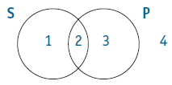
Venn Diagrams
We are going to start with the modern/Boolean interpretation, because it’s simpler and we can see the basic logical relations very easily.
A tool that logicians use to represent the meaning of standard form CPs is called a Venn Diagrams.
A VD is a graphical way or representing the relationship that exists between the categories named in the proposition.
Circles are used to represent the categories, and they are drawn overlapping so that we can capture the relationship articulated in the proposition.
The VD for a CP is composed of two overlapping circles (for the two classes named in the proposition).
Each standard form CP has a characteristic VD.

Slide 15
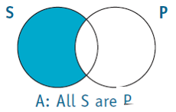
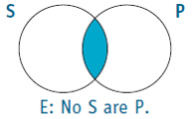
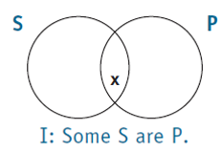
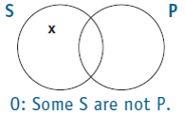
Venn Diagrams for Categorical Propositions (Boolean Interpretation)

Slide 16
The Modern Square of Opposition
The VDs for the standard form CPs help us see how the CPs are related to each other.
Compare the VDs for the A and the O form propositions. Notice that they assert contradictory relations. The A says that all of the subject class is in the predicate class; whereas the O says that there is at least one member of the subject class that is not in the predicate class.
What this shows us is that there is an explicit logical relationship between the A and the O form statements. If the A form statement is true, then the O form statement has got to be false.
The same relationship exists between the E and the I form statements.
This relationship is called the Contradictory relation, and it is represented in the diagrammatic expression of the logical relations operative in the Boolean context: the Modern Square of Opposition.

Slide 17
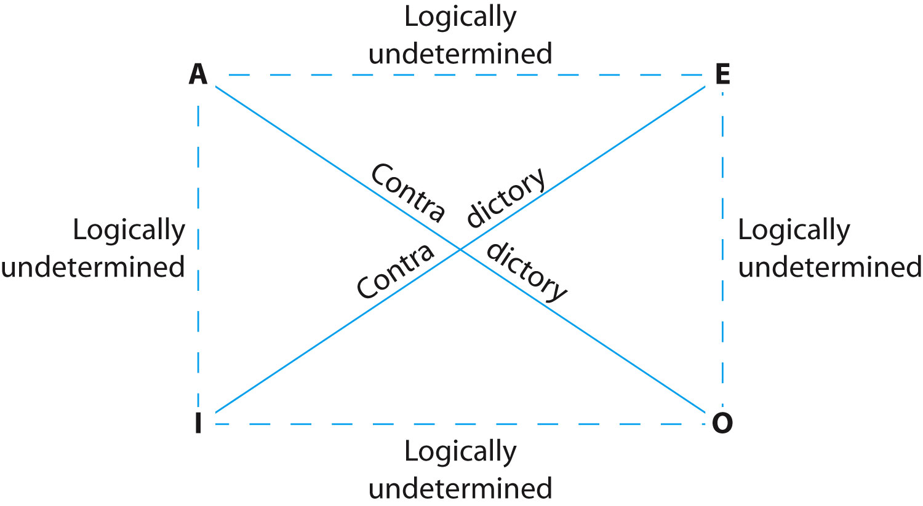
The Modern Square
Because it is closed to existence, the only logical relation that the modern interpretation permits is the contradictory relation.
It allows us to infer that if an A statement is true, the corresponding O is false, and vice versa.
The same is obviously the case for Es and Is.
All other possible relations between categorical propositions have no truth implications, and thus no logical determinacy.

Slide 18
Putting It To Work
We can use the contradictory relation highlighted by the modern square to specify the truth values of related propositions and to test what are called “immediate inferences.”
If the truth value of a particular CP is specified, the square can be used to make determinations about the truth value of related propositions.
These are very simple arguments, one premise and a conclusion. If the inference relies on one of the contradictory relations and we know the truth value of the premise, we can specify the truth value of the conclusion and thus determine if the truth of the premise guarantees the truth of the conclusion (determine if it’s a valid inference).

Slide 19
Exercises 5D
Example
Some violinists are not musicians with perfect pitch.
Answer
Let V = violinists, and P = musicians with perfect pitch.

Slide 20
The Operations
The system of logical evaluation made possible by the Boolean interpretation seems pretty limited. Only the contradictory relationship allows for any evaluation.
We can extend the system quite a bit to cover inferences to and from statements that don’t at first glance seem to be contradictories by noting relations of logical equivalence between standard and non-standard form propositions.
These are relations of logical synonymy. The propositions in question will always have the same truth value, so they can be plugged in for each other in an argument without changing the logical analysis of the argument.
There are three operations that can be used (in certain instances) to create such logical equivalencies. Here’s the first.
Conversion
Operation: Switch the subject and predicate terms of the proposition.
Range: produces logically equivalent propositions of E and I form statements.

Slide 21
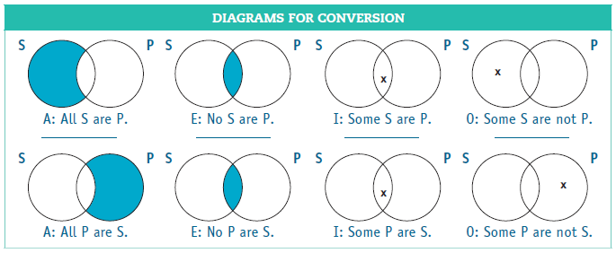
Conversion
In addition to representing standard form CPs, Venn diagrams can be used to illustrate the validity and invalidity of immediate inferences.
Here is the the modern interpretation illustrating conversion.

Slide 22
Obversion and Contraposition
Here are the other two: obversion and contraposition.
Obversion
Operation: This is a two step operation. Step 1 is to change the quality of the proposition (affirmative to negative, or vice versa). Step 2 is to replace the predicate term with its Term Complement (usually formed by appending non-to the term).
Range: Obversion creates logically equivalent statements with all standard form CPs.
Contraposition
Operation: Another two step operation. Step 1 is to switch the subject and predicate terms. Step 2 is to replace each term with its term complement.
Range: Contraposition creates logically equivalent statements with A form and O form statements.

Slide 23
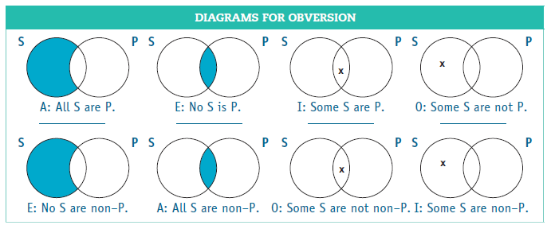
Obversion
Here’s the modern interpretation of Obversion.

Slide 24
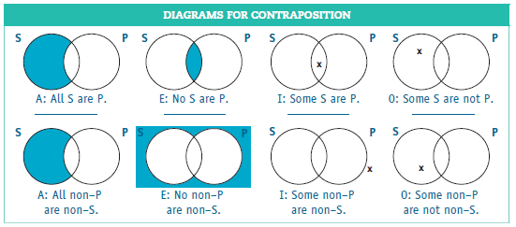
Contraposition
And here is the modern interpretation of Contraposition.

Slide 25
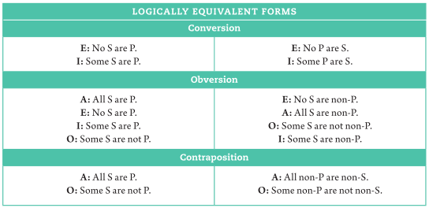
Summary of Conversion, Obversion, and Contraposition

Slide 26
Exercise 5E
Example
Some martial arts teachers are not tournament winners.
Answer
Converse: Some tournament winners are not martial arts teachers.
Obverse: Some martial arts teachers are non-tournament winners.
Contrapositive: Some non-tournament winners are not non-martial arts teachers.
(Conversion does not produce a logical synonym for O-propositions.)

Slide 27
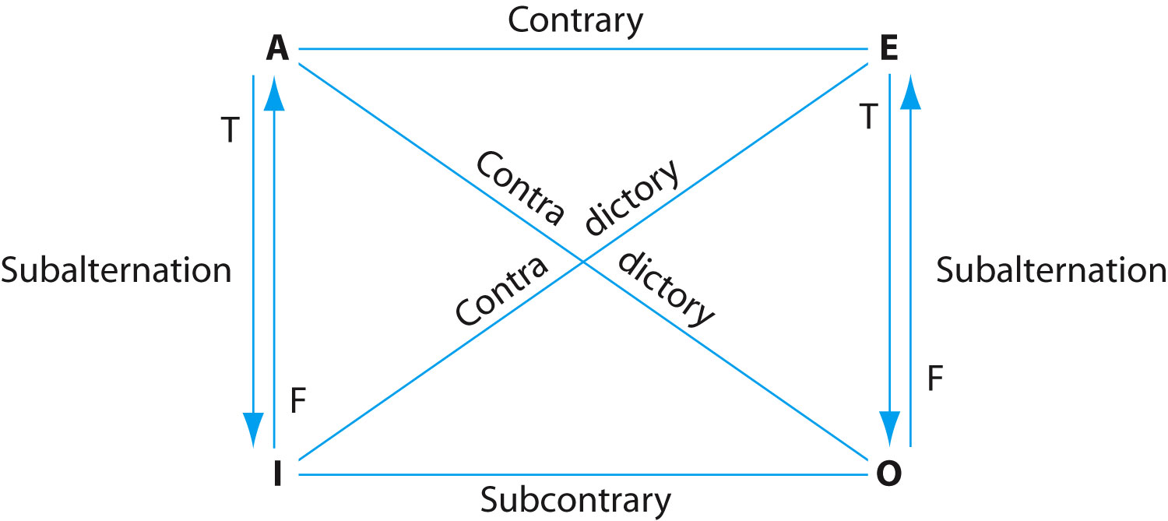
The Traditional (Aristotelian) Square of Opposition
The openness to existence of the Aristotelian standpoint produces a much richer field of logical evaluation.
The traditional square reveals this richness.
Contradictories: A-O and E-I (same as modern square)
Contraries: A-E (can’t both be true, can both be false).
Subcontraries: I-O (can both be true, can’t both be false)
Subalternation:
Truth “Flows Down” from A-I and E-O
Falsity “Flows Up” from I-A and O-E

Slide 28
Immediate Inferences and Fallacies with the Traditional Square
Like we did with the modern or Boolean square, we can use the Traditional Square of opposition to test immediate inferences.
Now, however, the range of inferences that we can successfully evaluate is much broader, because it includes all of the possible inferences captured in the contrary, subcontrary and subalternate relations.
There is also a broader range of formal fallacies that reference this expanded range of relationships: illicit contrary, illicit subcontrary, and illicit subalternation.
There is also a version of the existential fallacy specific to the Aristotelian interpretation. In instances when this fallacy is possibility, we can establish conditional validity and then determine if the class named by the subject term of the universal proposition has any actual members.

Slide 29
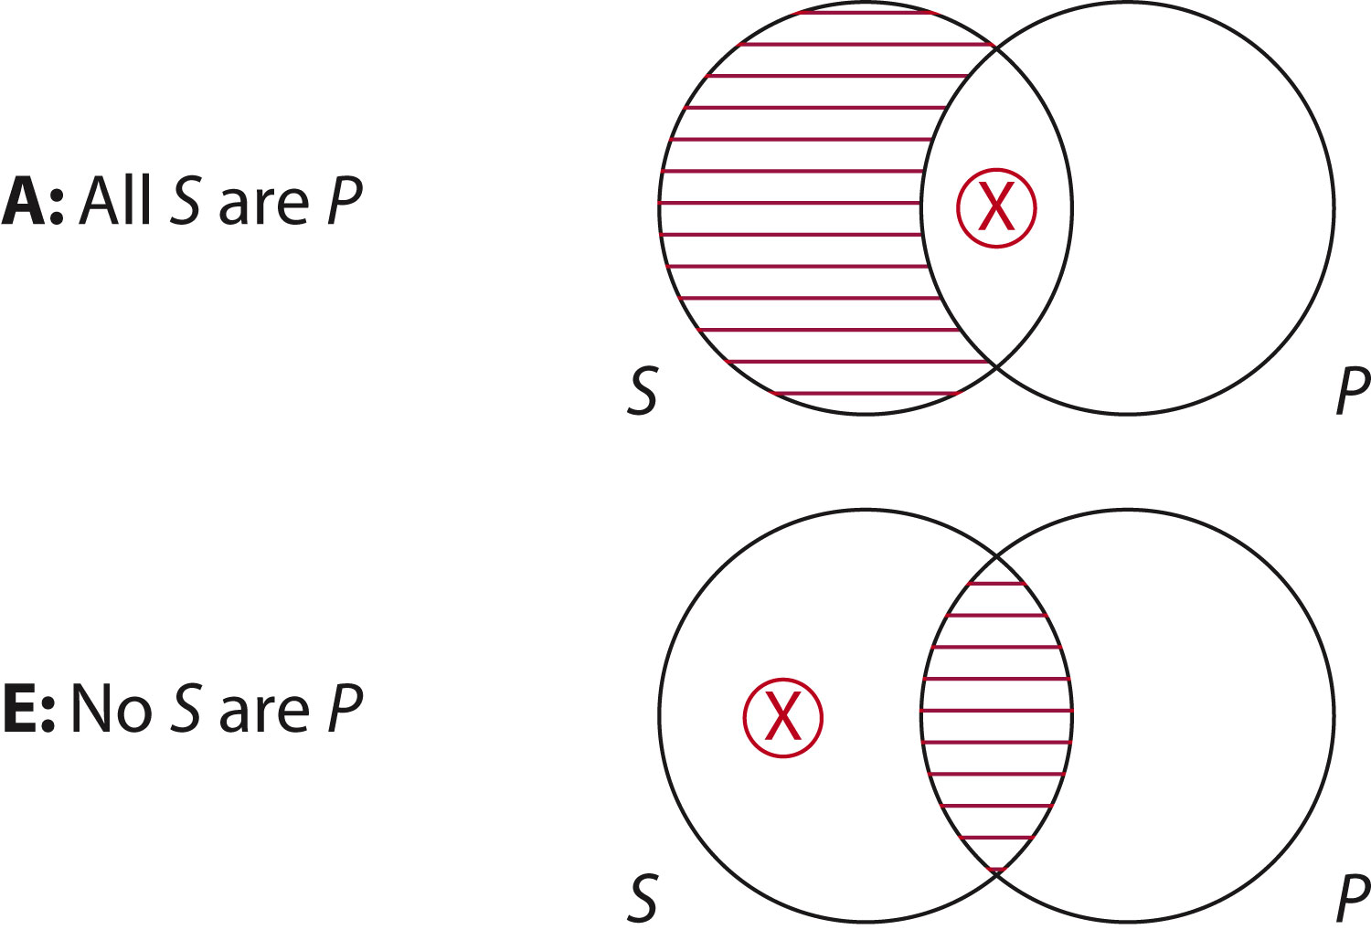
Venn Diagrams and the Traditional Standpoint
The Aristotelian standpoint requires that we add a new symbol to our Venn diagrams.
A circled ‘x’ represents the existential assumption that is made by the Aristotelian standpoint .
We can use our modified Venn diagrams to test the traditional square of opposition and as another way of testing immediate inferences.

Slide 30
Immediate Inferences in the Traditional Square
We can use the traditional square, just like we used the modern one, to test the validity of immediate inferences.
Premise: All clowns are scary people.
Conclusion: Some clowns are scary people.
This argument is valid in the traditional perspective, because a true A specifies the truth of the corresponding I by the subalternate relationship.
It is invalid from the modern perspective.
Compare:
All clowns are scary people. Therefore, no clowns are scary people.
In this case, the contrary relationship says that corresponding As and Es cannot both be true, so if the A is true, the E has to be false. But the conclusion says the E is true, so this is an invalid argument.
It obviously invalid from the modern perspective as well.

Slide 31
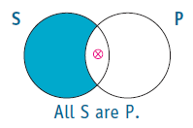
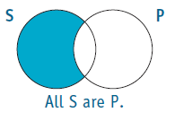
Exercises 5F
Example
All world travelers are cosmopolitan persons.
Therefore, some world travelers are cosmopolitan persons.
Answer (comparison)
Modern interpretation
INVALID: The I-proposition requires an “X” in the area between S and P.
Traditional interpretation
PROVISIONALLY VALID: The I-proposition follows based on the assumption of existence.

Slide 32
Conversion, Obversion, Contraposition in the Traditional Square
Conversion: has “Conversion by limitation”
Obversion: same as in Modern Square
Contraposition: has ‘Contraposition by limitation’
Notes:
I made single quotes double quotes

Slide 33
Conversion in the Traditional Square
Conversion valid (E, I): Interchange subject and predicate terms
Conversion by limitation valid (A): Change A-proposition into its corresponding I-proposition, then convert
Convertend A: All carrots are vegetables.
Corresponding particular I: Some carrots are vegetables.
Converse I: Some vegetables are carrots.
Conversion not valid (O)
Convertend O: Some vegetables are not carrots.
Converse O: Some carrots are not vegetables. (not a valid immediate inference)

Slide 34
Contraposition in the Traditional Square
Contraposition valid (A, O): Exchange subject with predicate; then replace each with term complements
A: All S are P.
Contrapositive A: All non-P are non-S.
Contraposition by limitation valid (E): Change an E-proposition into its corresponding O-proposition; then apply contraposition
E: No gorillas are lions.
Corresponding particular O: Some gorillas are not lions.
Contrapositive I: Some non-lions are not non-gorillas.
Contraposition not valid (I)
I: Some humans are non-registered voters.
Contrapositive I: Some registered voters are non-humans.

Slide 35
Exercises 5G
Example I
The subcontrary of “Some columnists are coffee drinkers” is
(a) All columnists are coffee drinkers.
(b) No columnists are coffee drinkers.
(c) Some columnists are not coffee drinkers.
Answer
(c) is correct. Since “Some columnists are coffee drinkers” is an I-proposition, its subcontrary must be an O-proposition.
(a) is an A-proposition, the superaltern of an I-proposition.
(b) is an E-proposition, the contradictory of an I-proposition.

Slide 36
Exercises 5G
Example II
If it is true that “Some physicians are not good communicators,” then the proposition “No physicians are good communicators” is
True
False
Undetermined
Answer
c. Undetermined. The first is an O-proposition, and if true, its superaltern, the E-proposition, could be true or false.

